Slide 1


Towards a Logic of «Food Waste»
Andrea Borghini
Department of Philosophy, University of Milan
Culinary Mind
16th International Conference on Biomedical Ontology (ICBO 2025)
November 14, 2025

Slide 2
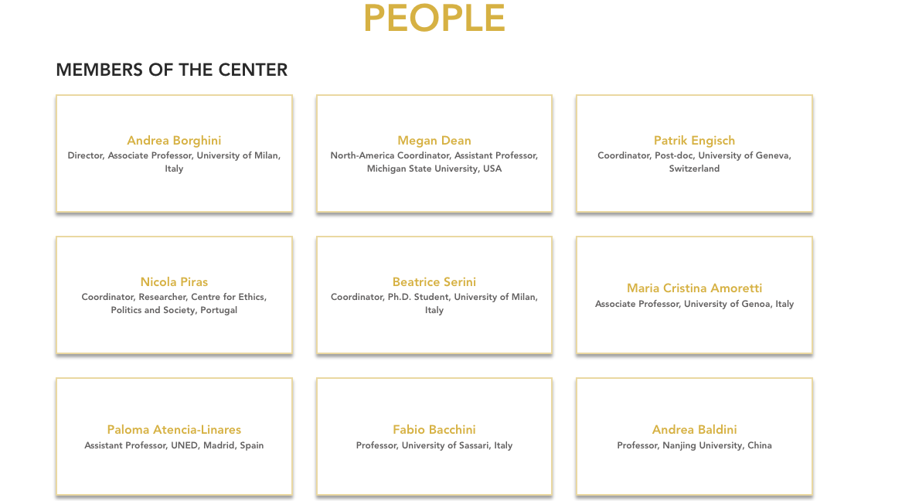
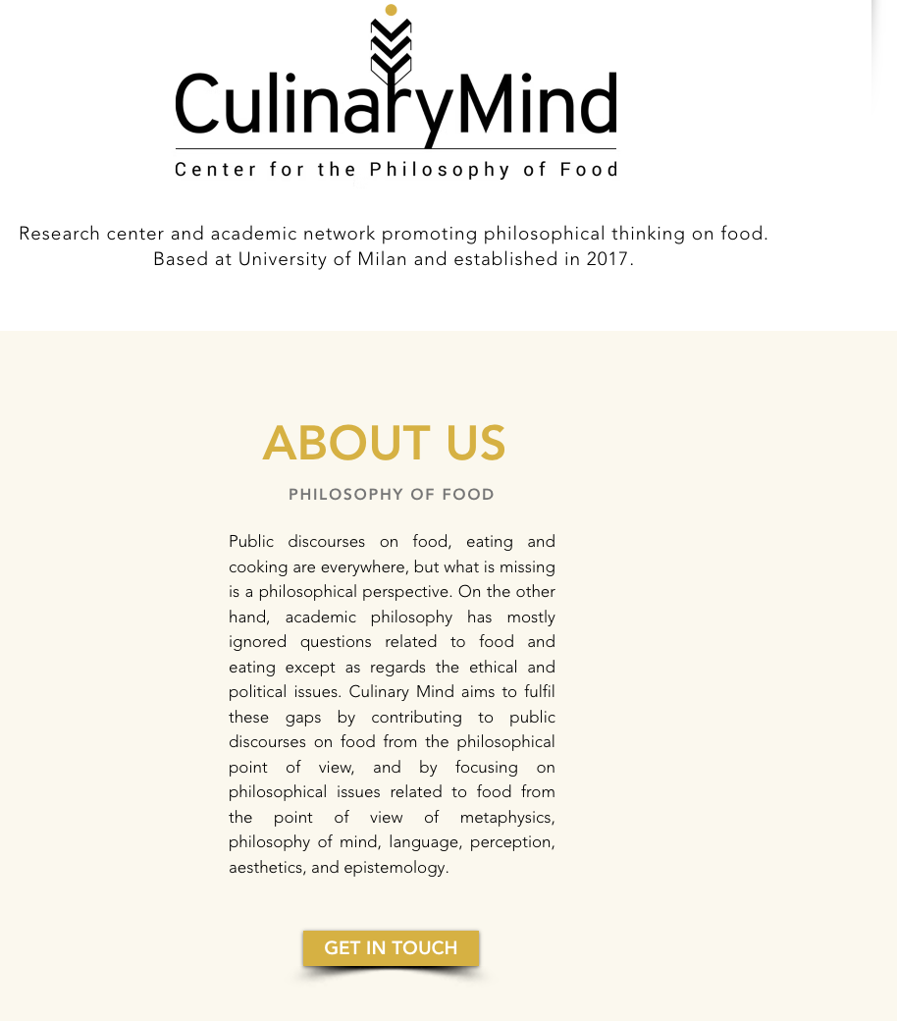
Research Network

Slide 3
Research Team
Beatrice Serini
PhD (2025), U. of Milan
Nutrition science
Nicola Piras
Full Researcher
U. Do Minho, Portugal
Giorgio Ubbiali
Postdoc, Brixen
Food ontology
Matteo Gandolini
PhD (2025), U. of Milan & Institute Lyfe, Lyon
Children food ontology & psychology
Elena Bossini
PhD Candidate (2026), U. of Sassari
Spaces of novel/lab/artificial meat
Laura Gagliardi
PhD Candidate (2026), U. of Milan & Institute Lyfe, Lyon
Psychology of meat disgust
Emma Hardy
PhD Candidate (2025), U. of Michigan
Metaphysics of Food
Tias Maity
PhD Candidate (2025), Alliance U., Bangalore
Food Heritage in Cheese carving
Michelangelo Bestazzi
PhD Candidate (2028), U. of Minho
Food as Soft Power
Maxime Barbier
PhD Candidate (2026), U. of Milan & Institute Lyfe, Lyon
Wine Tasting Expertise & Epistemology
Matilde Pileri
PhD Candidate (2028), U. of Sassari
Communicating Sustainability in the Food Domain

Slide 4
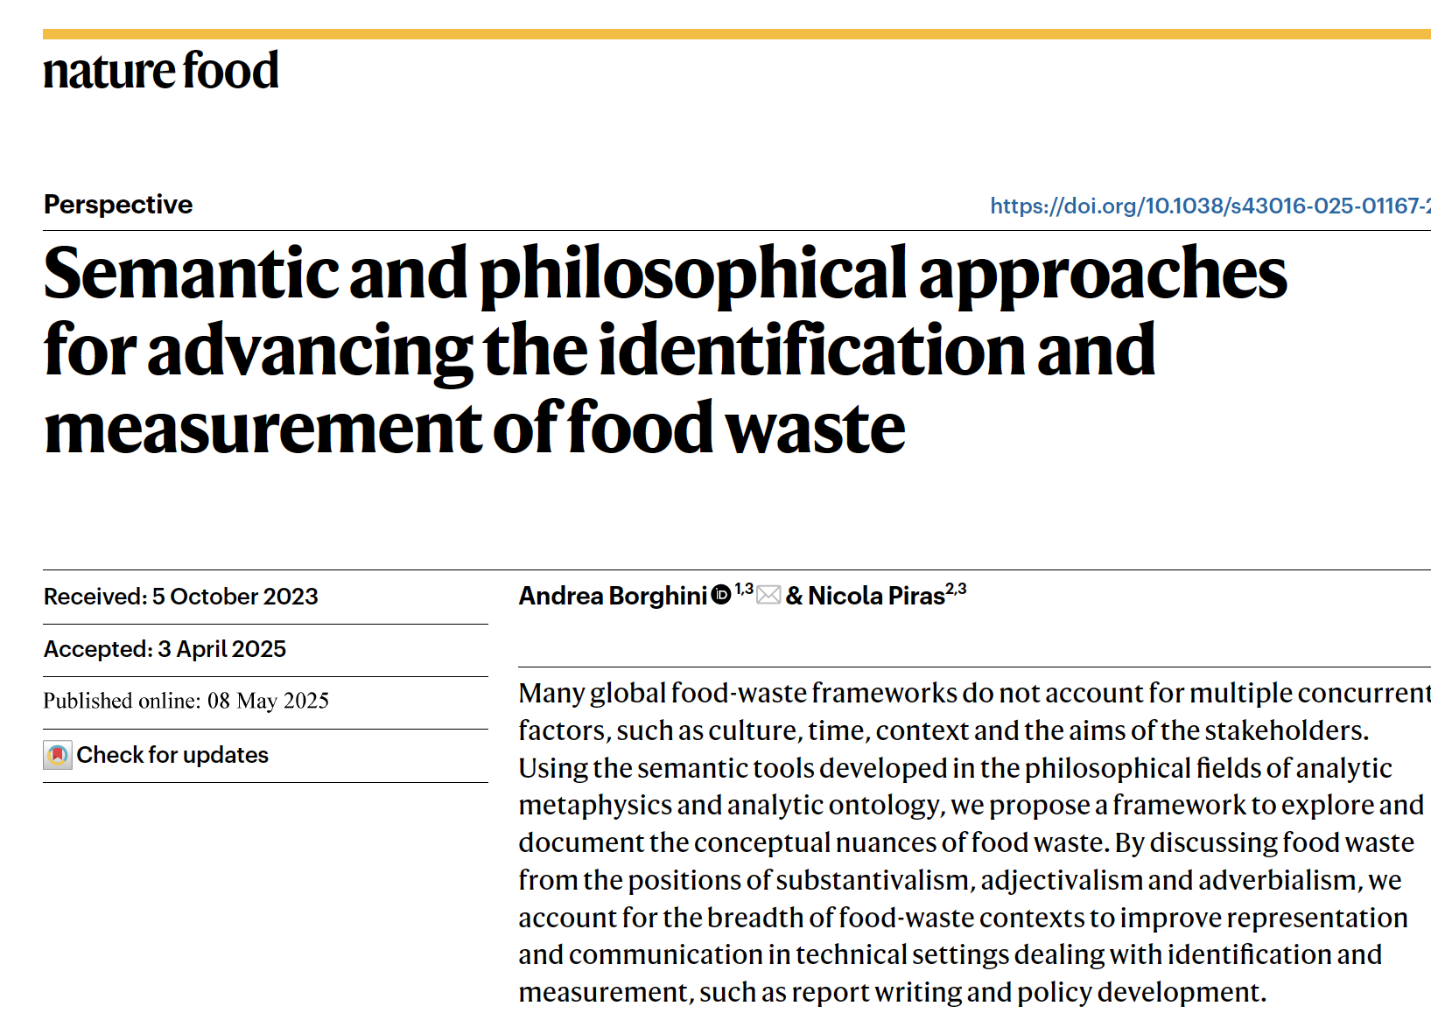

This Research
with Nicola Piras

Slide 5
SEMANTIC
MESSINESS

Slide 6
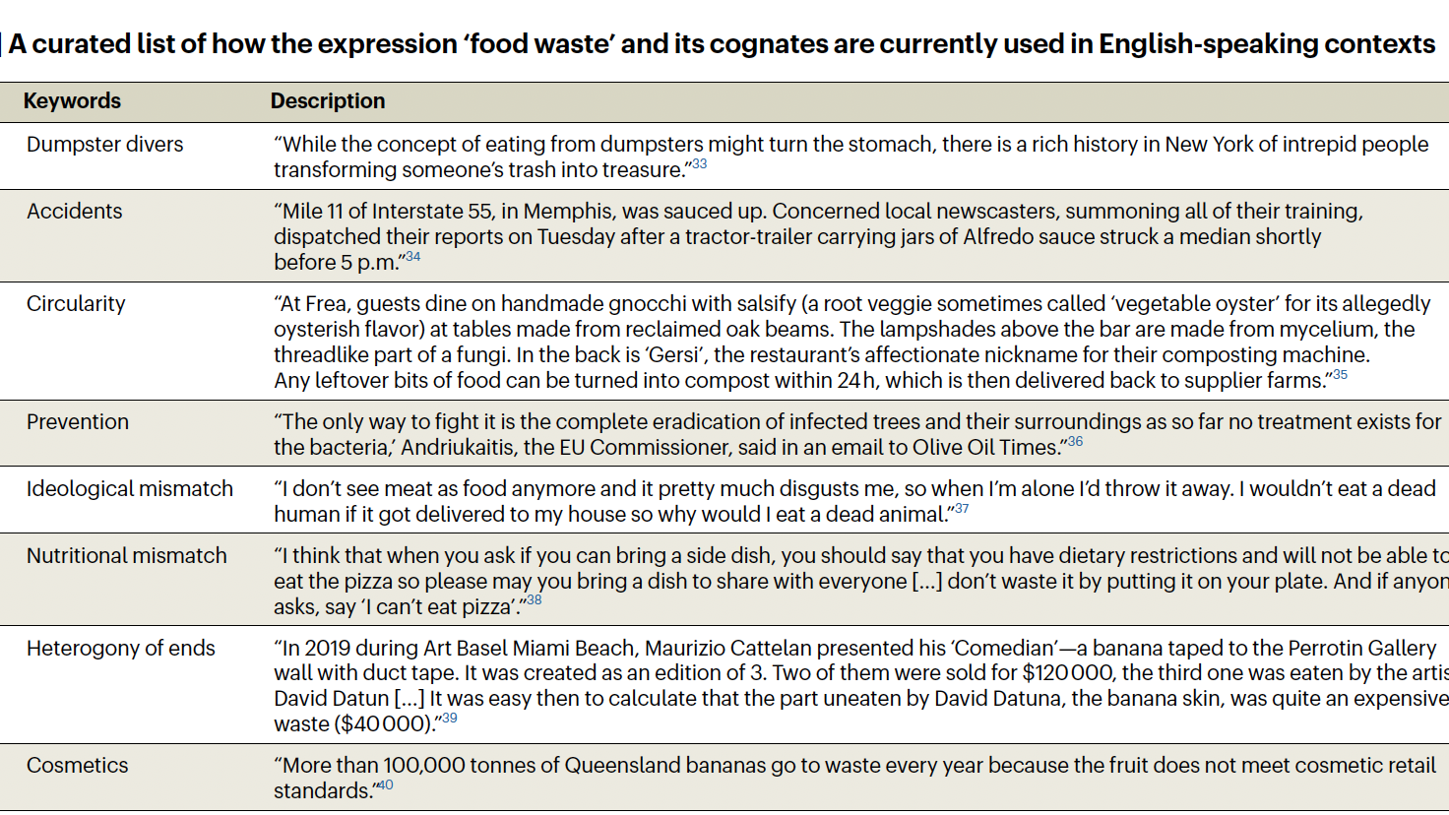

Slide 7
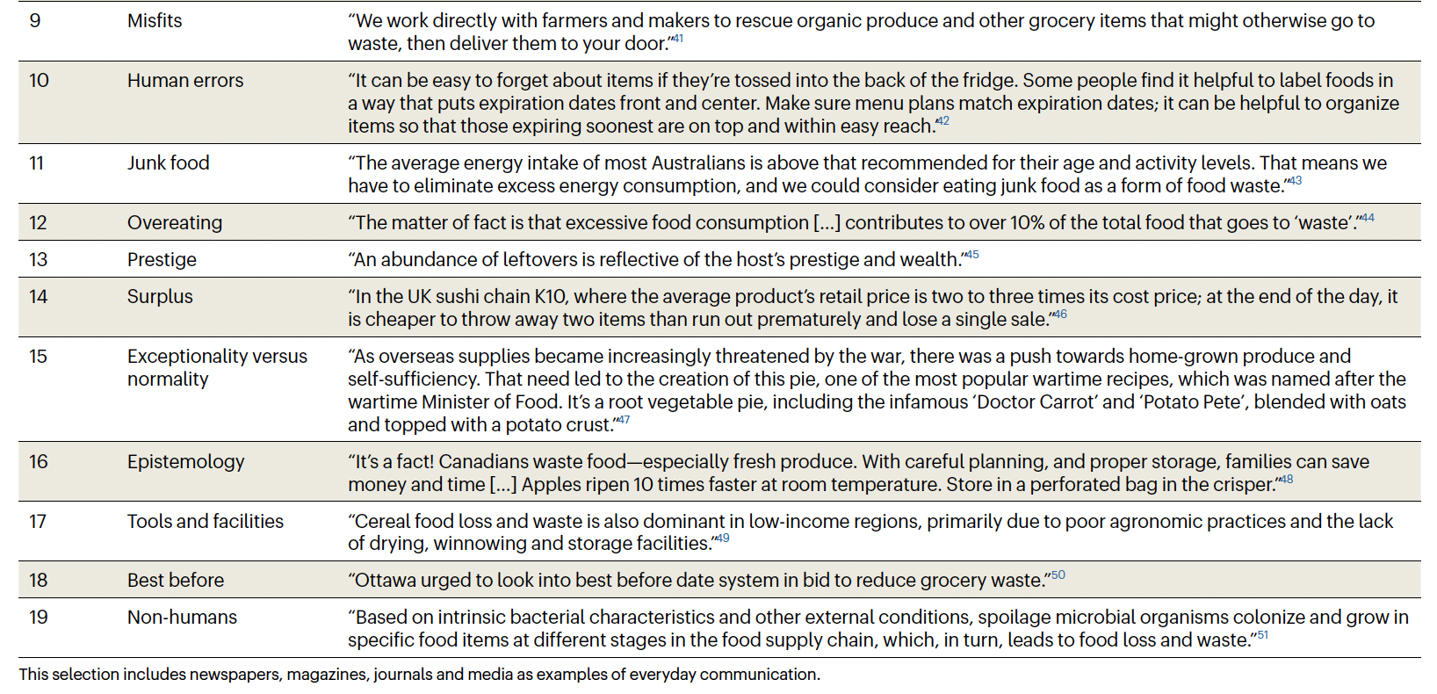

Slide 8
Thus, there is no consensus on how much exactly goes to waste. According to Parfitt and colleagues, “Ranges between 10 and 40 percent of total global food production and as high as 50 percent are quoted, but on closer examination, these estimates all link back to the same limited primary datasets.”

Slide 9
TOWARDS
A CONCEPTUAL SCHEME:
EIGHT CRITERIA

Slide 10
1. Reversibility
A food waste definition should account for items that at a point of their cycle, may later become non-waste again.

Slide 11
2. Relationality
A food waste definition should account for items along with the specific relations that make those items food waste.

Slide 12
3.
Possibility
A food waste definition should account for items considering also their likelihood to become waste.

Slide 13
4.
Vagueness
A food waste definition should account for items whose status as “food waste” is sometimes undetermined.

Slide 14
5.
Value-Sensitivity
A food waste definition should account for the value judgments involved in terming something as “food waste.”

Slide 15
6.
Agentivity
A food waste definition should account for all the different kinds of agents related to the production of food waste who can be aware, unaware, identifiable, unidentifiable, human or non-human; who can have different beliefs, perspectives, and ends in regard to food waste.

Slide 16
7. Exceptionality
A food waste definition should account for those exceptional cases where food waste can change its meaning failing to apply to usual items.

Slide 17
8.
Luck
A food waste definition should account for factors beyond human control which are not predictable and thus unavoidable.

Slide 18
THREE
SEMANTIC
PERSPECTIVES

Slide 19
1. SUBSTANTIVALISM
1. Uniqueness: if something is food waste, then it cannot be food, as food waste is no longer edible or may be harmful to health
2. Irreversibility: food that has become waste cannot be turned into food again

Slide 20
At the food-systems level, for example, crop over-production could be considered as a source of food loss or as a mechanism to strengthen food security. Substantivalism lacks the theoretical resources to report that the discarded good is loss only according to one of the two positions, because it is committed to a uniqueness assumption.

Slide 21
2. ADJECTIVALISM
“Discussions of food waste should be reframed away from the concept of ‘waste.’ […] Referring instead to ‘wasted food’.”
=> Wasted’ stands for a property. But what kind of property? We do not typically perceive wastedness—we perceive, for example, food being rotten, which is not equivalent to wastedness.

Slide 22
3. ADVERBALISM
Adverbialism amends the language of the theory by introducing an ad hoc adverb, such as ‘wasting’, and replacing every occurrence of ‘waste’ with its adverbial counterpart, according to a specified translation schema.

Slide 23
DEVELOPING
ADVERBIALISM:
adverbial modifier

Slide 24
THREE OPTIONS
NOUN-MODIFIER: ‘there is a wasting banana in the fridge’
PREDICATE-MODIFIER: ‘there wasting is a banana in the fridge
SENTENCIAL MODIFIER: ‘wasting, there is a banana in the fridge’
=> WORKING HYPOTHESIS: SENTENCIAL MODIFIER

Slide 25
ROADMAP: 1
Expressing the 8 criteria via a sentential modifier in first-order logic.
For instance, REVERSIBILITY obtains when:
“Wasting, Px” is true at time t1 & “It is not the case that: wasting, Px” is true at time t2
[with t2 occurring after t1]

Slide 26
ROADMAP: 2
Moving from: conceptual schema in first-order logic
to: conceptual schema in domain ontology
and eventually: conceptual schema in OWL

Slide 27

Grazie!
andrea.borghini@unimi.it
http://www.filosofia.unimi.it/borghini/
https://culinarymind.org/

